Slide 1
Soap
Describe how soap is made from fatty acids and alkalis
Describe the uses of organic acids in soaps and detergents
Describe the uses of sodium hydroxide to illustrate its economic importance in producing soaps

Slide 2

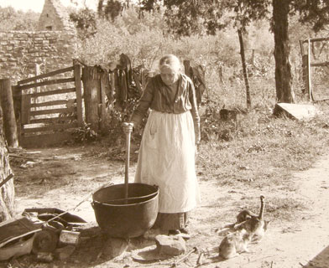
SOAP
Soap is one of the earliest detergents. It is known to have been used for 3000 years.
The raw materials needed to make soap are fats or oils and an alkali such as sodium hydroxide.

Slide 3
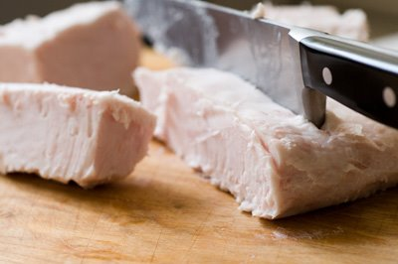
WATER - LIMITATIONS
The fat would have come from an animal, e.g. sheep, and the alkali made from the chemicals present in the ashes of a fire.
1 can of lye (sodium hydroxide), 12 ounces 3 pounds of lard Water

Slide 4
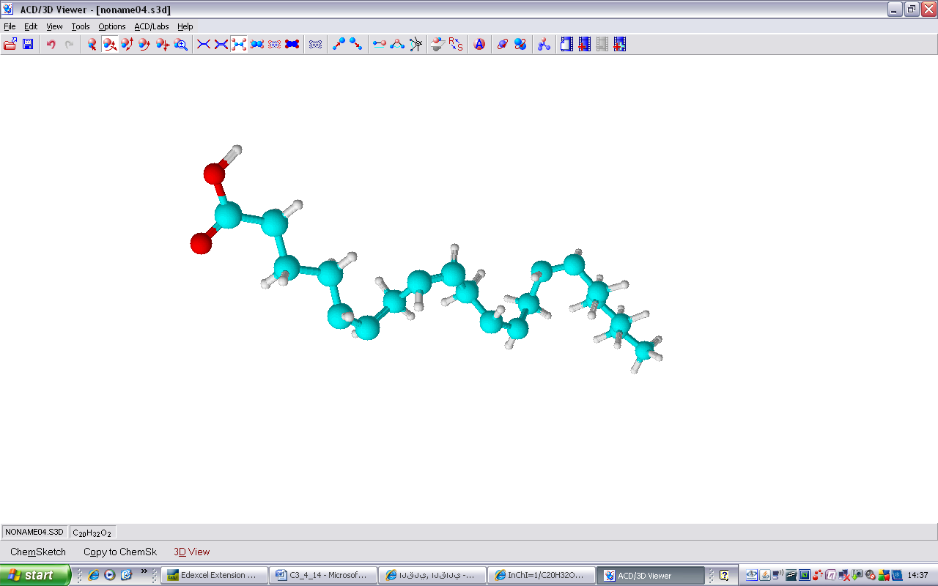
WATER - LIMITATIONS
Fats and oils are examples of esters (a family of organic compounds). They are formed from the reaction between organic acids and alcohols.
Organic acids contain the carboxyl group, COOH, and a long hydrocarbon chain:

Slide 5
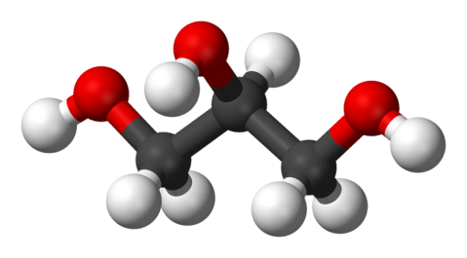
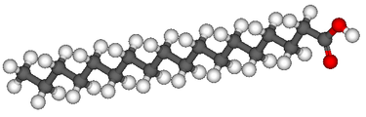
SOAP
e.g. Stearic acid is a saturated fat that's mainly in animal products.
+
C₁₈H₃₆O₂
C₃H₃(OH)₃
glycerol
Stearic acid
Glyceryl sterate + water

Slide 6
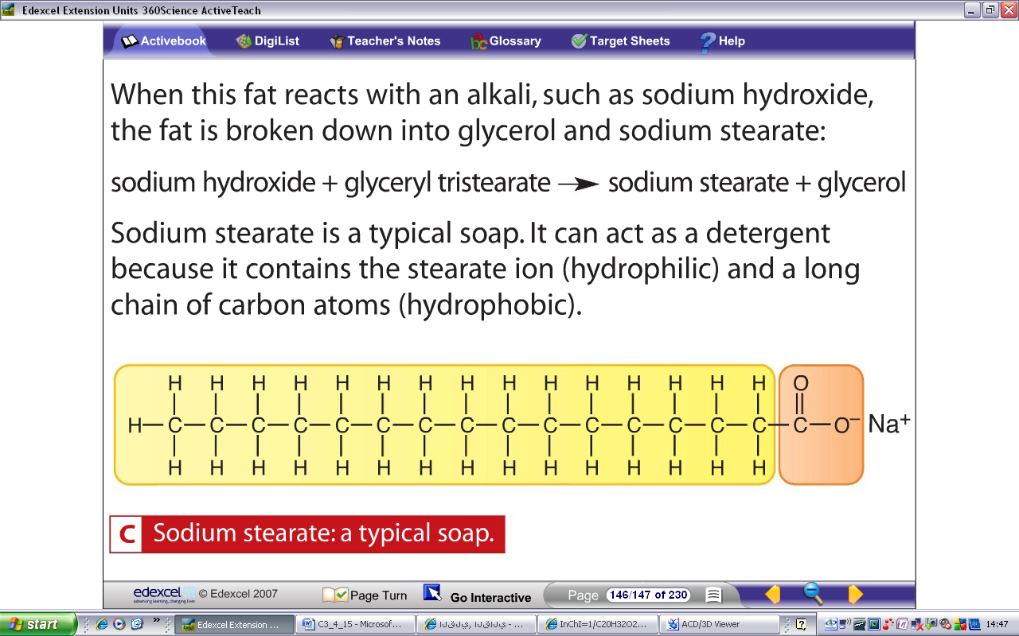
SOAP
When glyceryl stearate is boiled with alkali the following reaction occurs:
sodium + glyceryl → sodium + glycerol
hydroxide tristearate stearate
(ALKALI) (ESTER) (SOAP)
When the sodium stearate is first added to water it dissolves and the stearate ion is released:

Slide 7
SOAP
As with any detergent, the hydrocarbon tail is…
HYDROPHOBIC (water hating / grease loving)
the ionic head is…
HYDROPHILIC (water loving / grease hating)

Slide 8
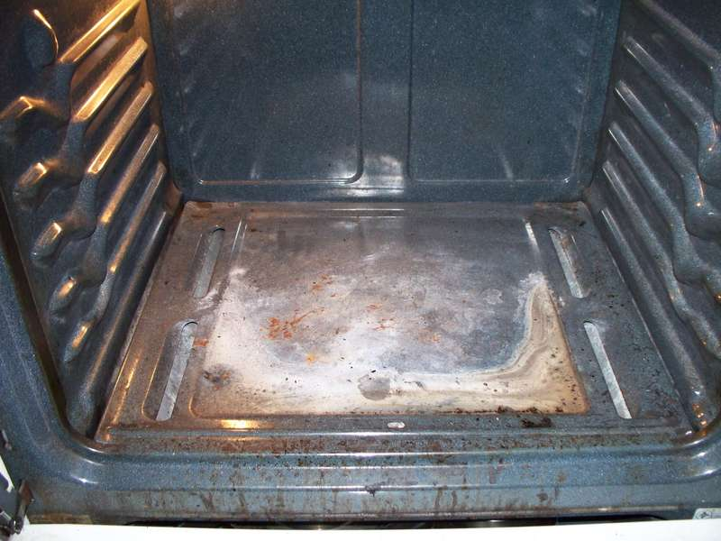
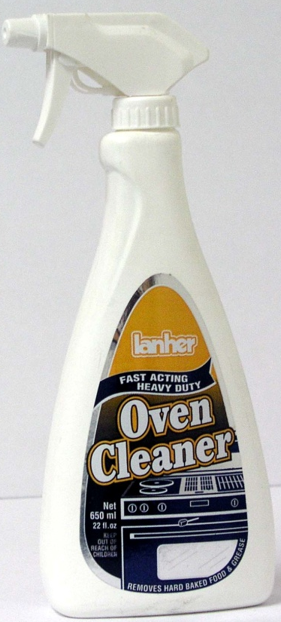
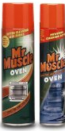
OVEN CLEANERS
The inside of an oven becomes coated with fats from the cooking of food, especially meat.
Oven cleaners contain strong alkalis that react with the fats to form a soap. This can then be removed easily with a wet cloth.

Slide 9
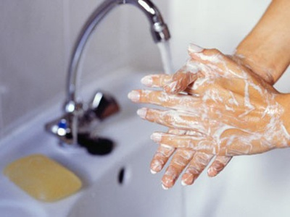
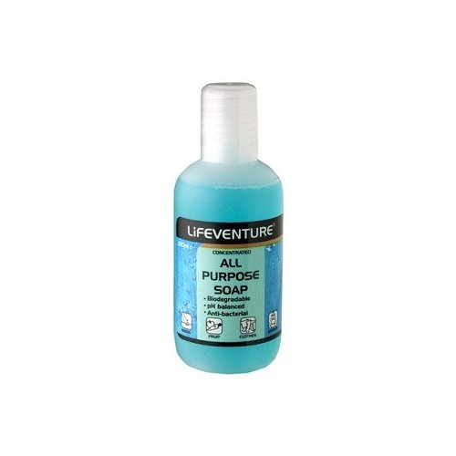
SOAPS
Soaps themselves are often slightly alkaline.
The surface of our skin is covered in oils and these can react with the alkaline soap to form more soap and thus removes the oils and makes our skin feel ‘dry’..
The more expensive soaps contain ‘moisturisers’ that restore the skin to its normal state.
pH balanced soaps are also available – soaps that have a pH similar to that of our skin - about 5.5. These are referred to as pH balanced soaps.

